Slide 1
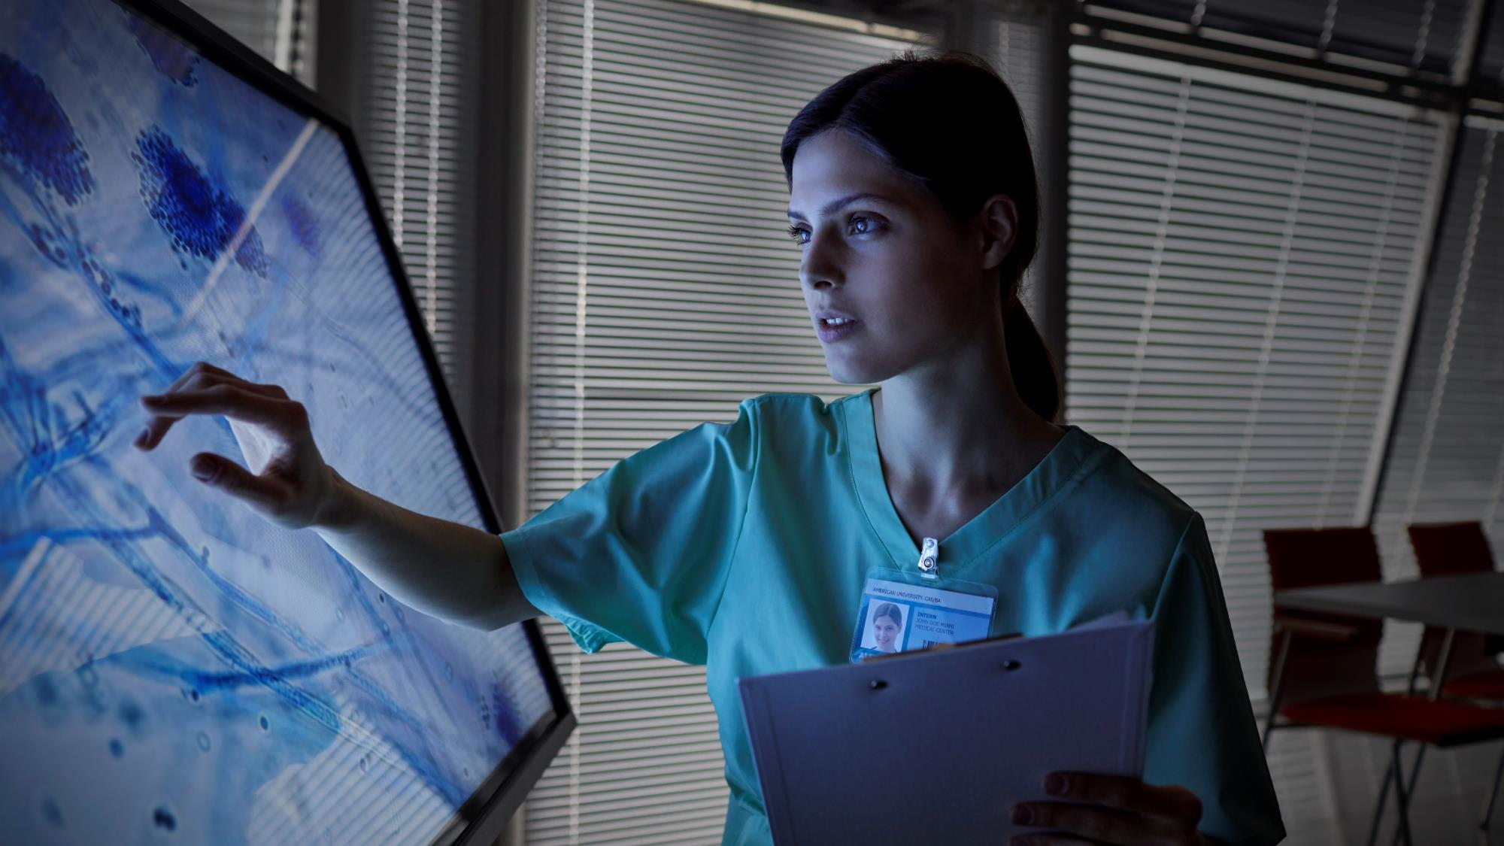
Twitter Vaccine NLP Analysis
By: The A-Team

Slide 2
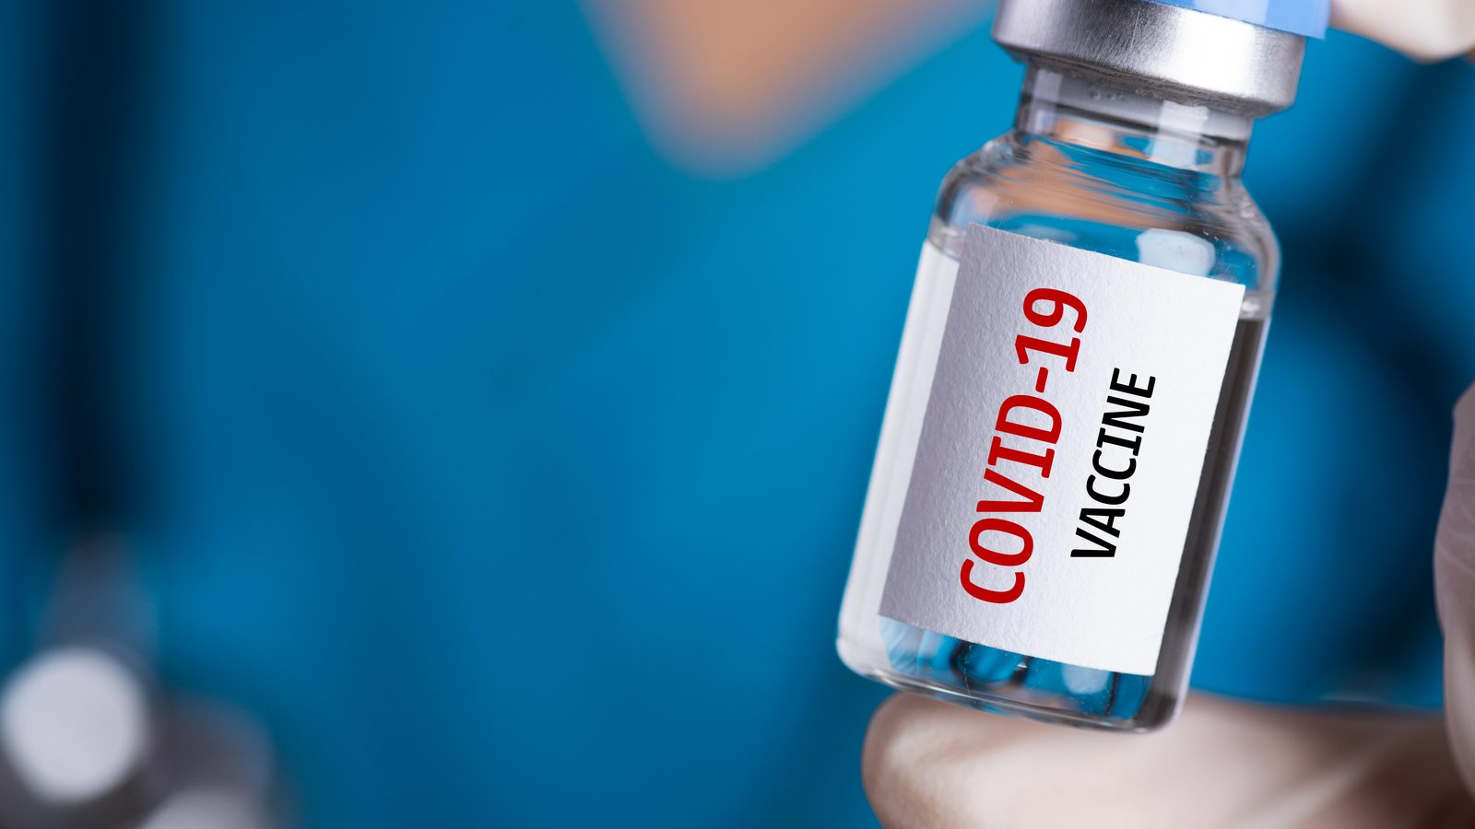
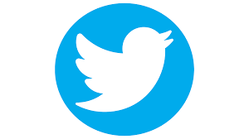
#covidvaccine
How can we leverage twitter to
optimize the perception of our vaccine?

Slide 3
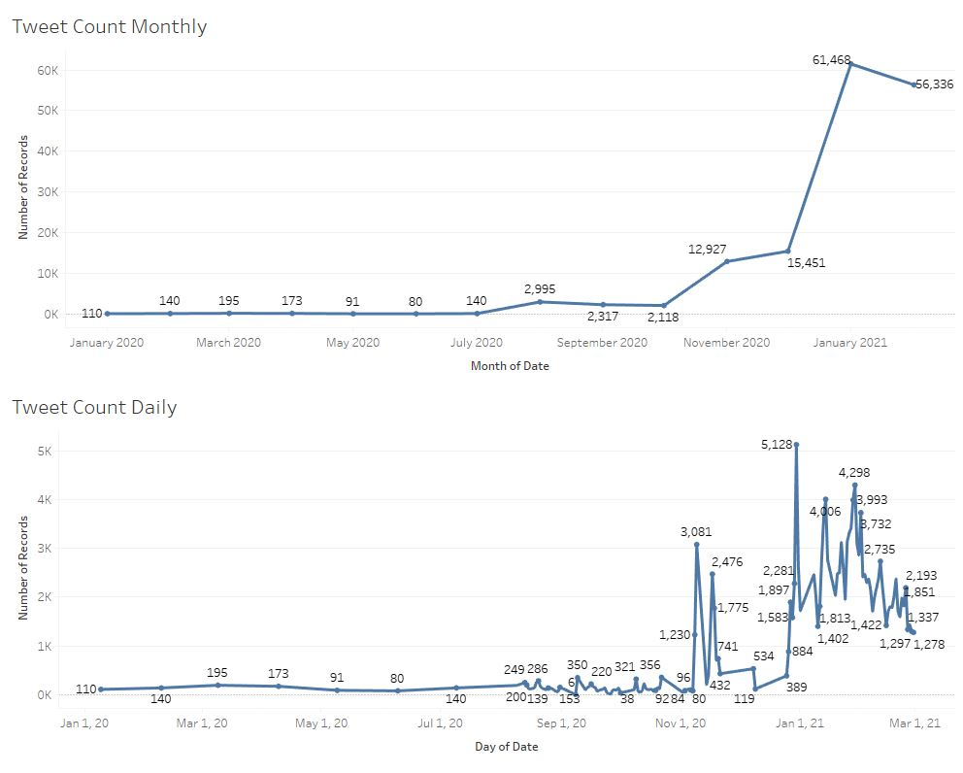

Slide 4
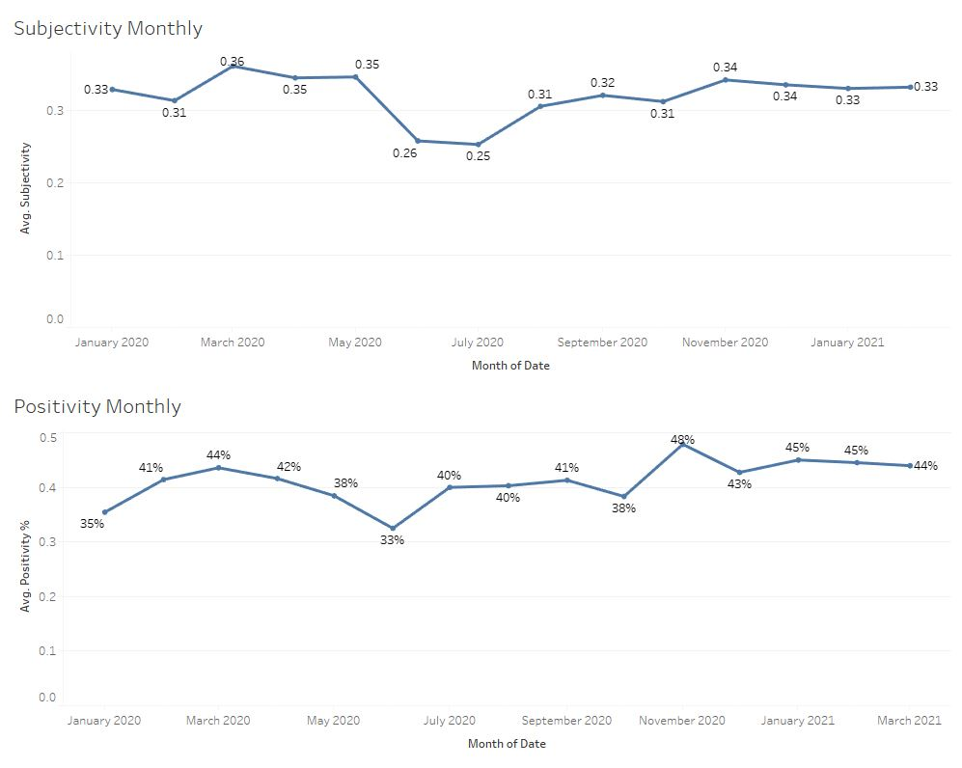

Slide 5
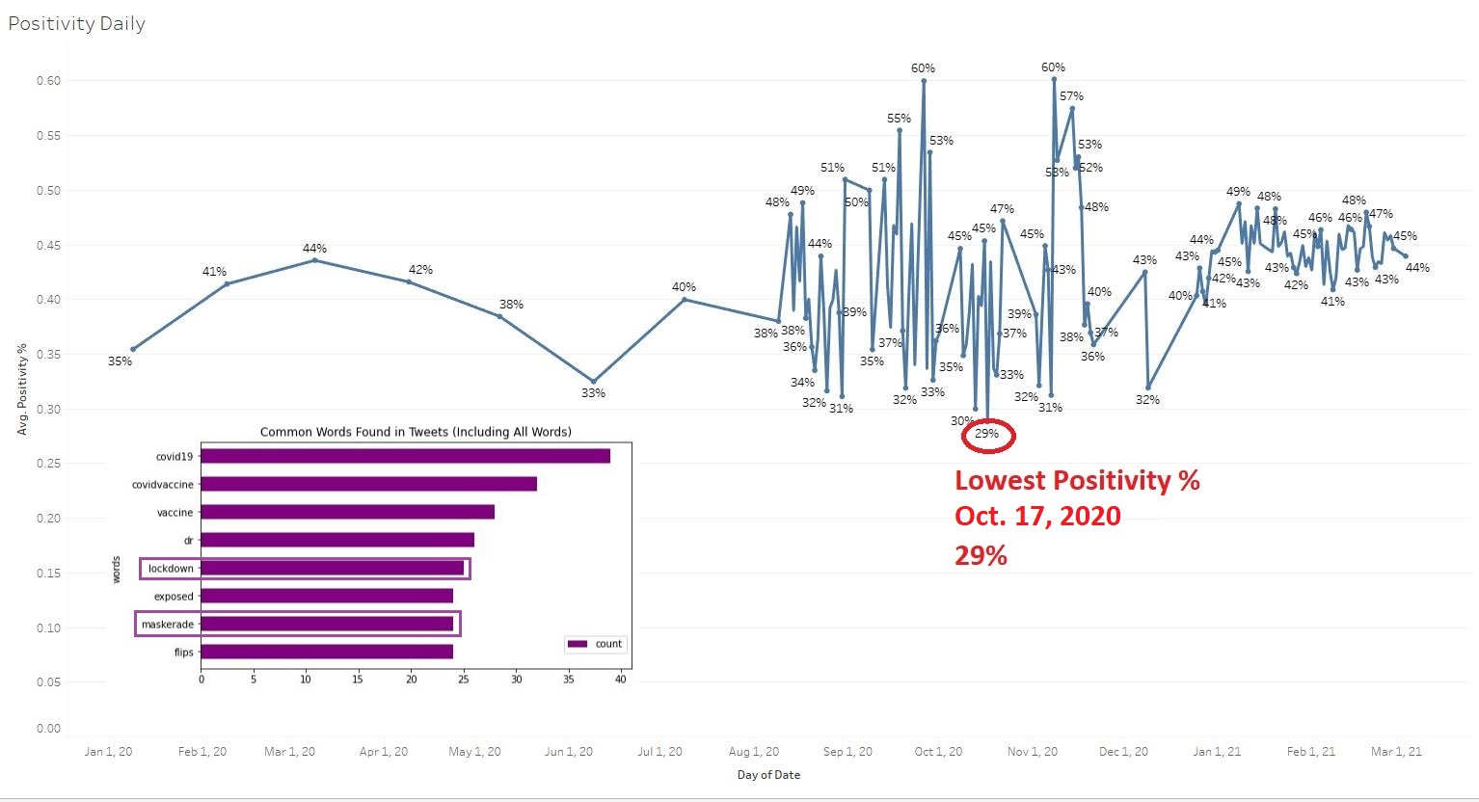

Slide 6
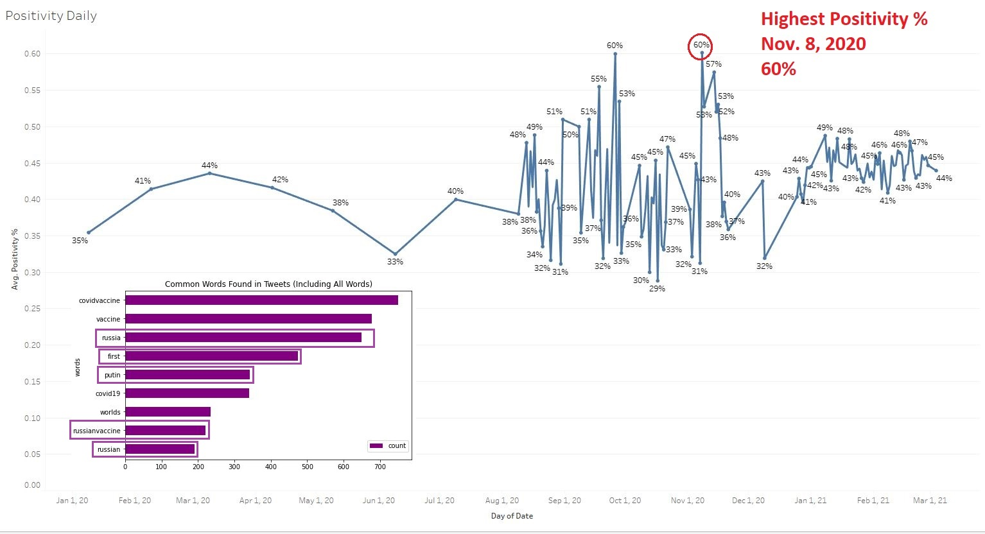

Slide 7
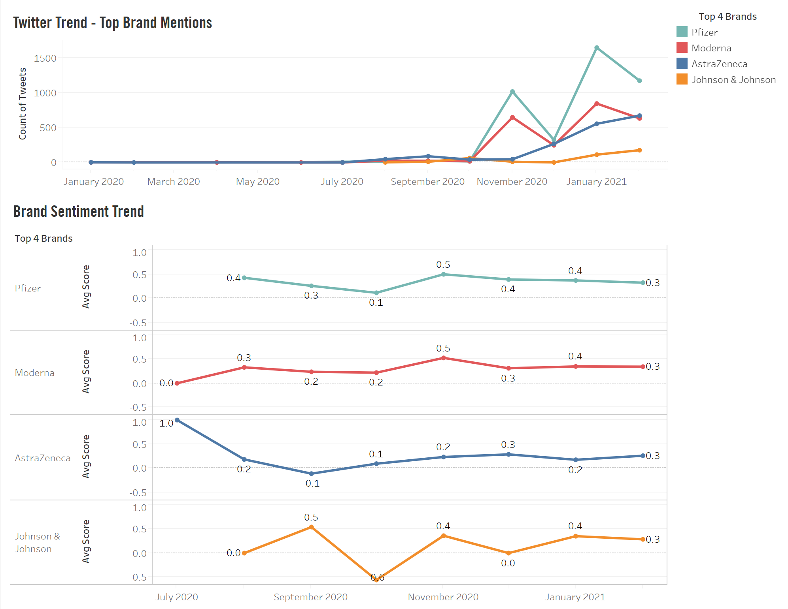
Positive
Neutral
Negative
Positive
Neutral
Negative
Positive
Neutral
Negative
Positive
Neutral
Negative

Slide 8
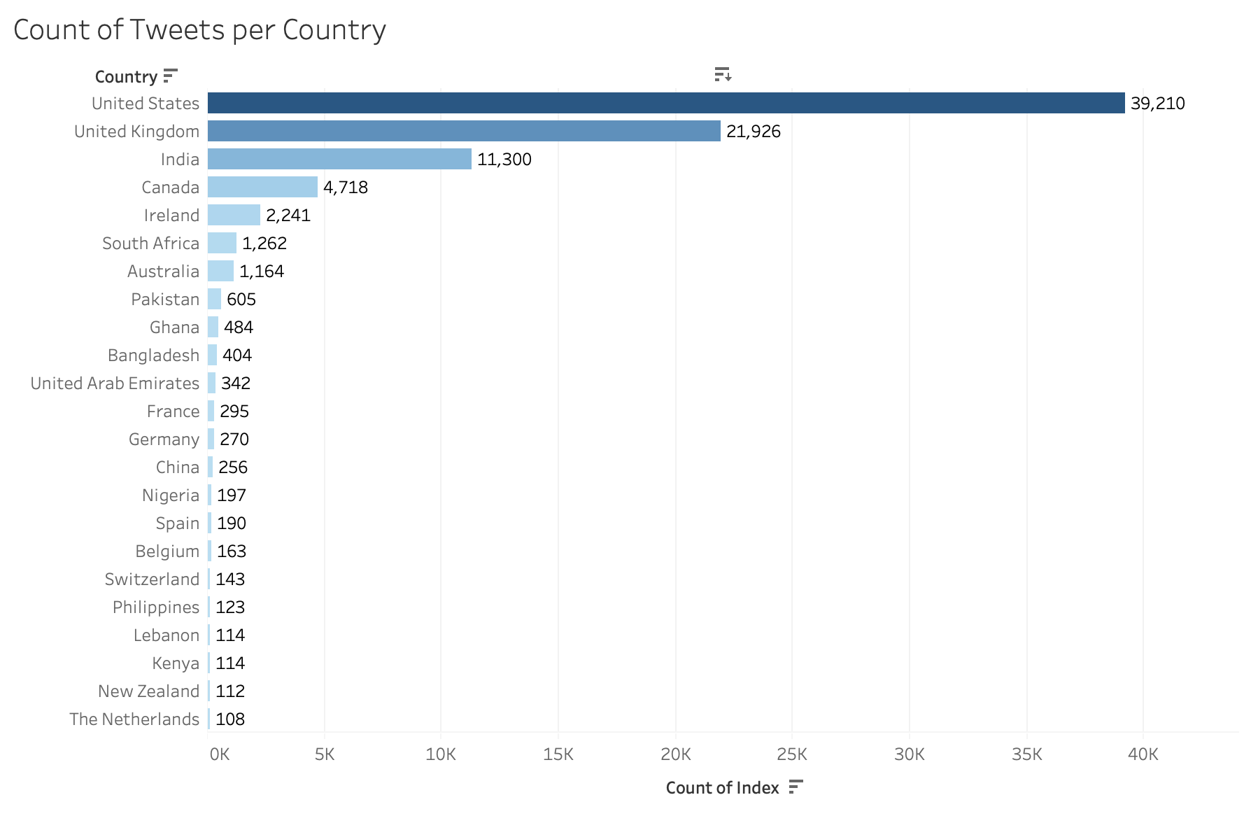

Slide 9
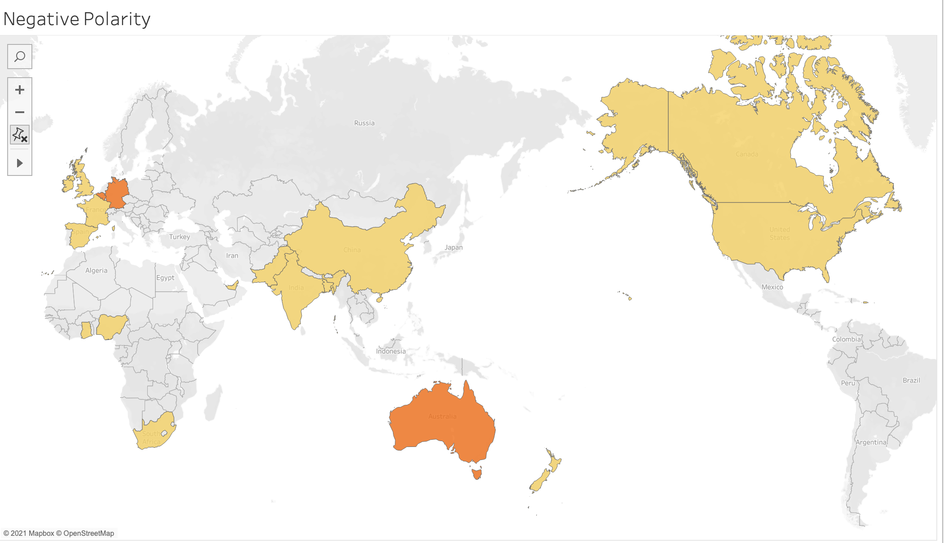
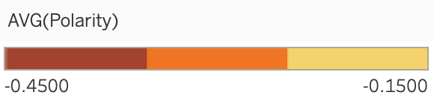

Slide 10
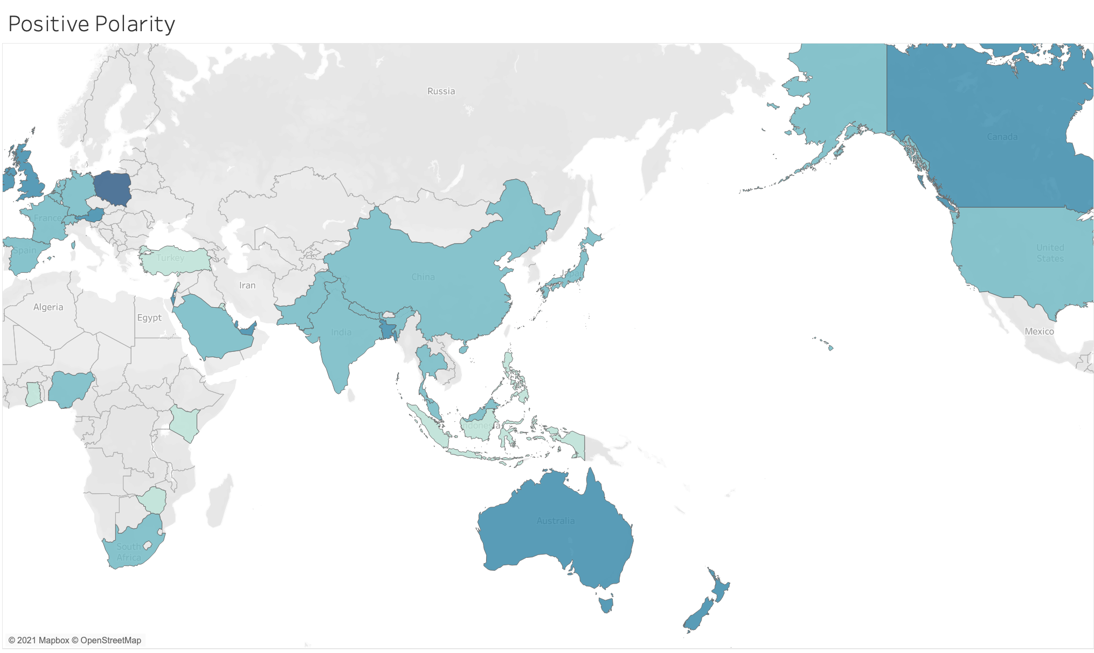
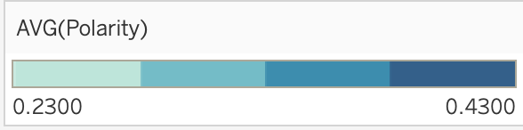

Slide 11
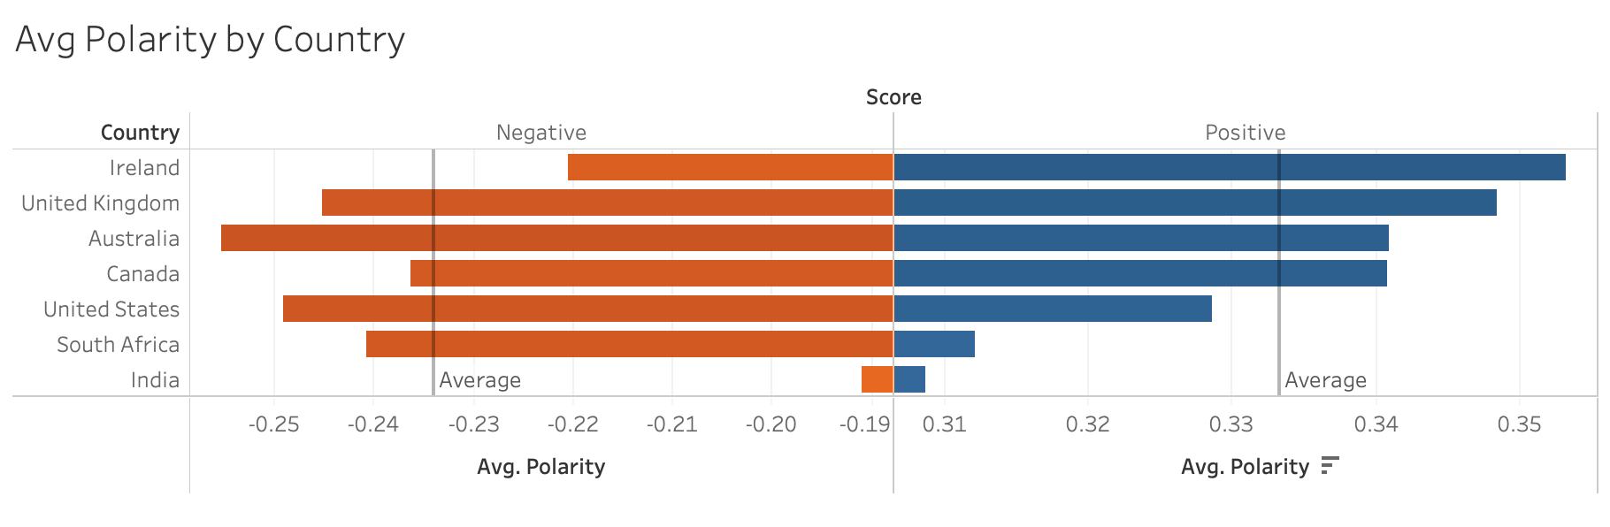

Slide 12
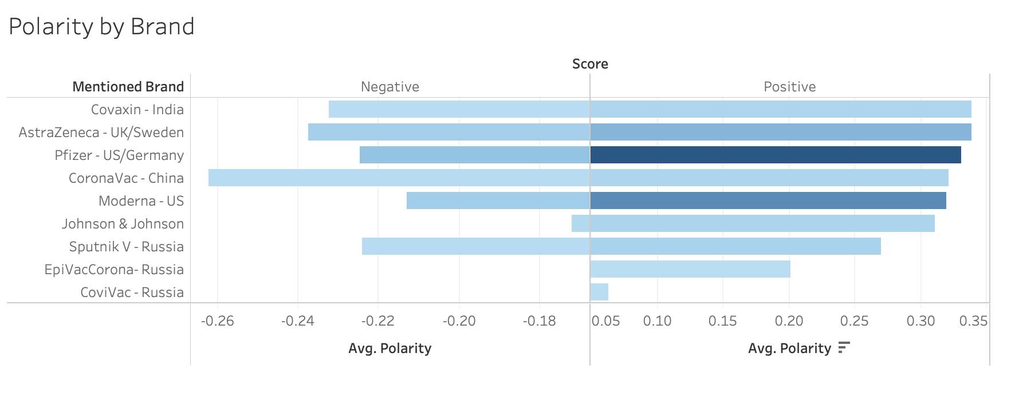

Slide 13
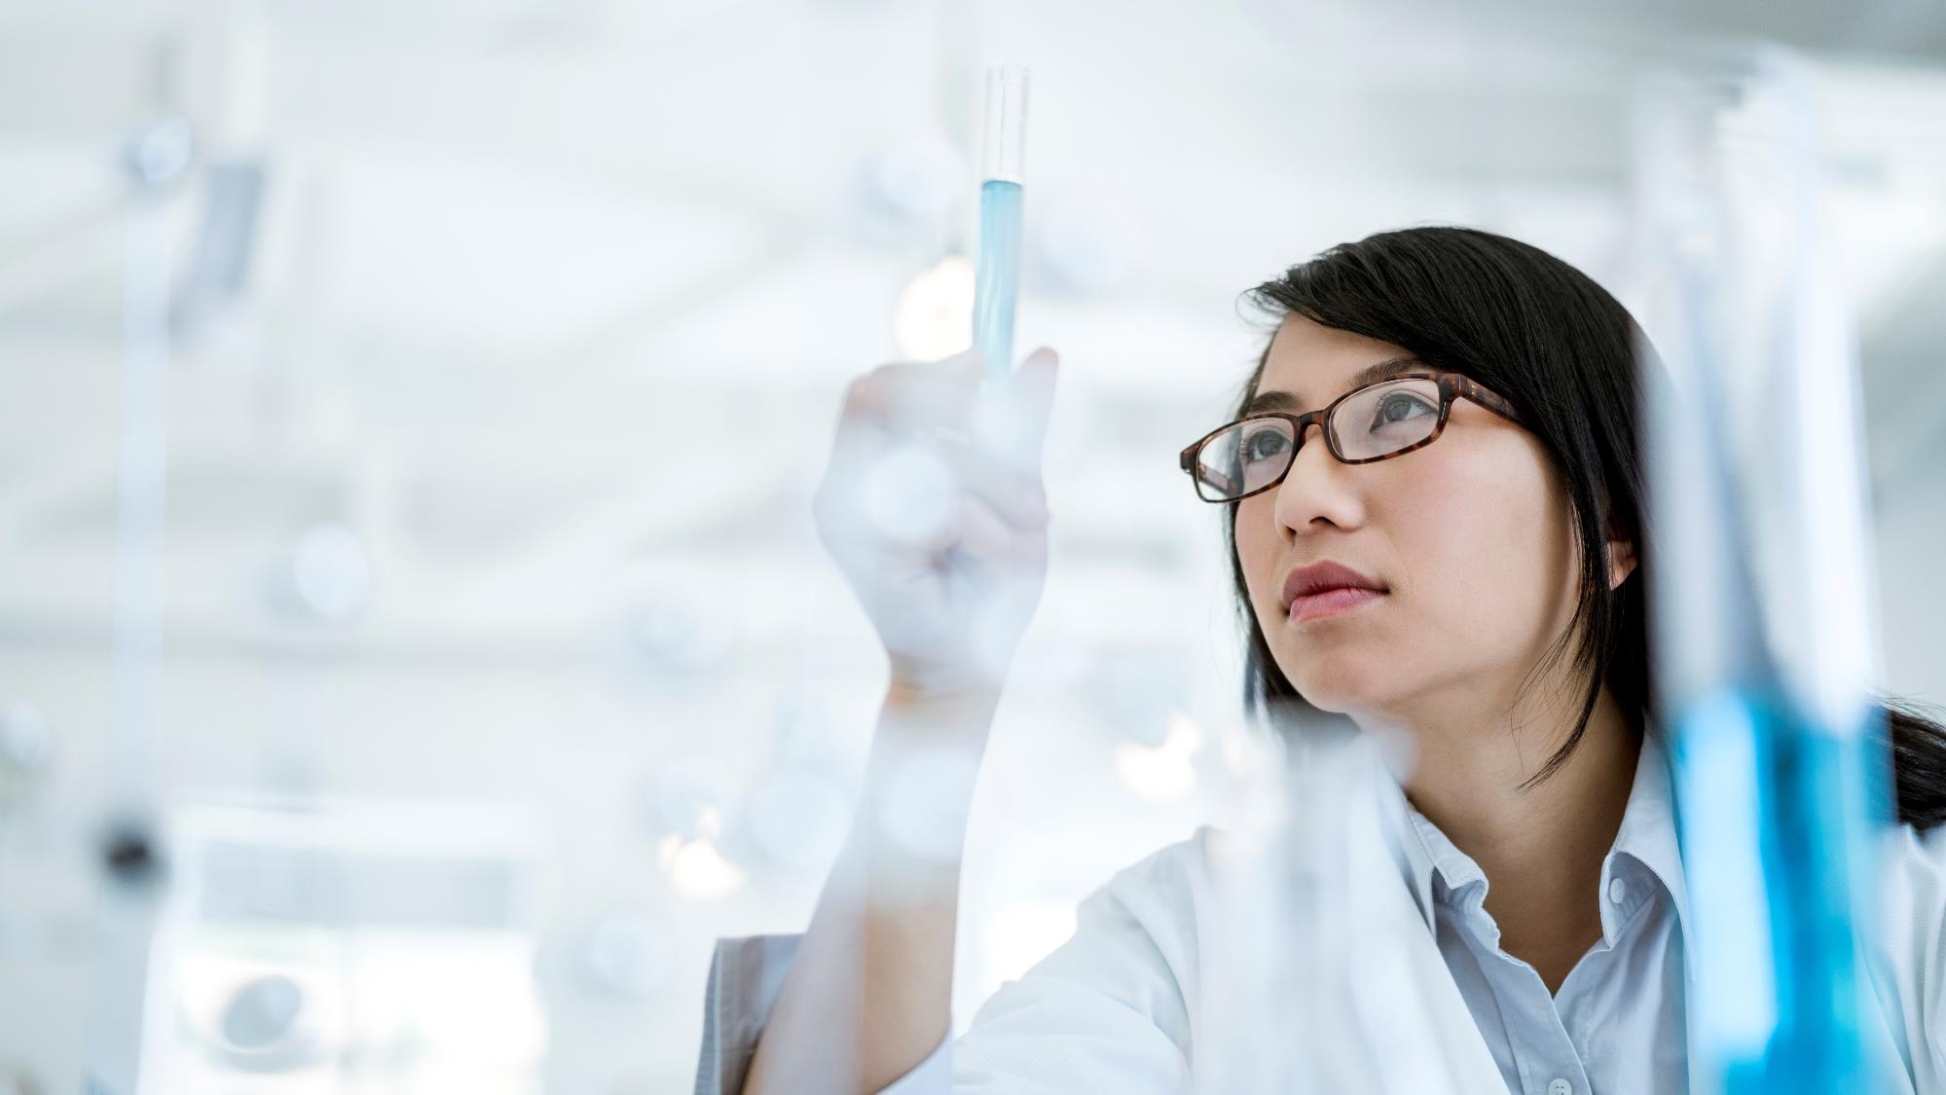
CONCLUSION
Over time, there is an increasing trend in positive sentiment
All big 4 vaccine manufacturers had ebbs and flows, but all have positive sentiments
Sentiment is positive globally
Sentiment increase when brands are discussed

Slide 14
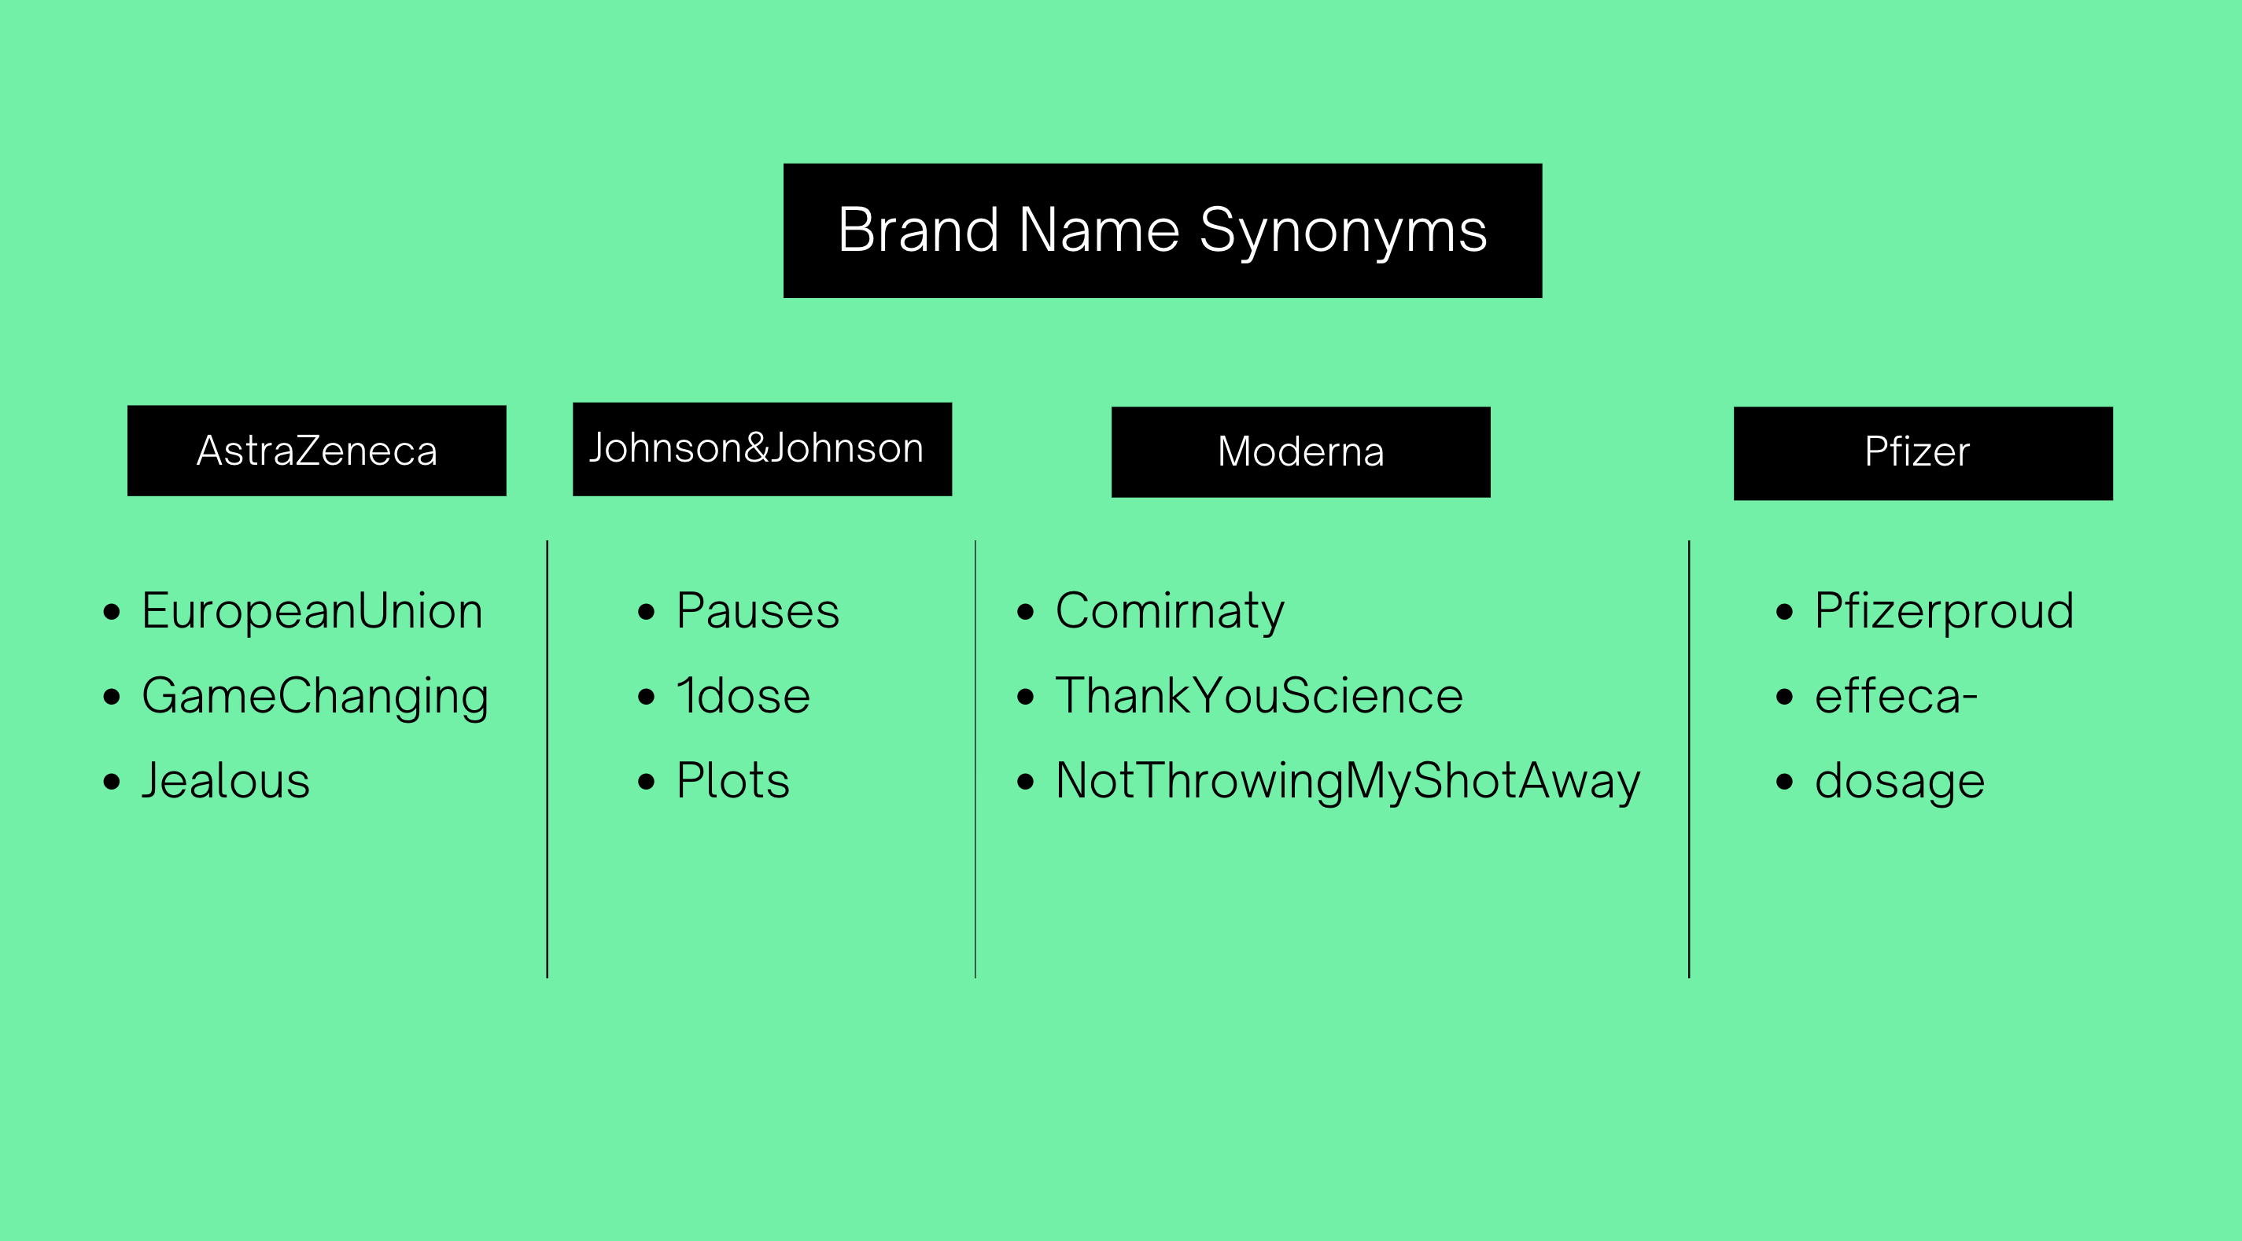

Slide 15


Slide 16
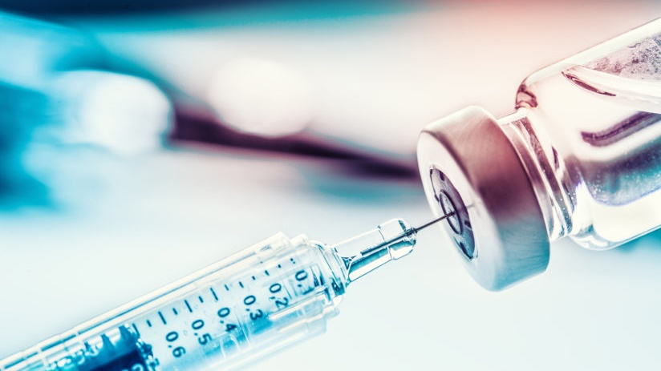
Thank You

